Slide 1
Overview

Slide 2
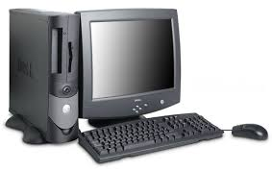
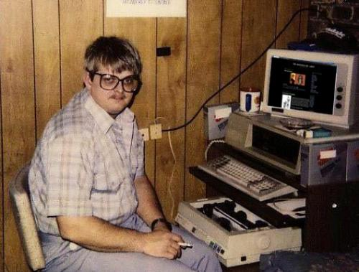
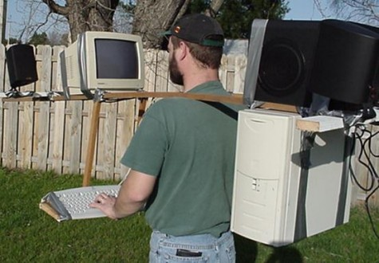
What is a Computer?
A device capable of recording and manipulating data and performing arithmetical and logical problems.

Slide 3
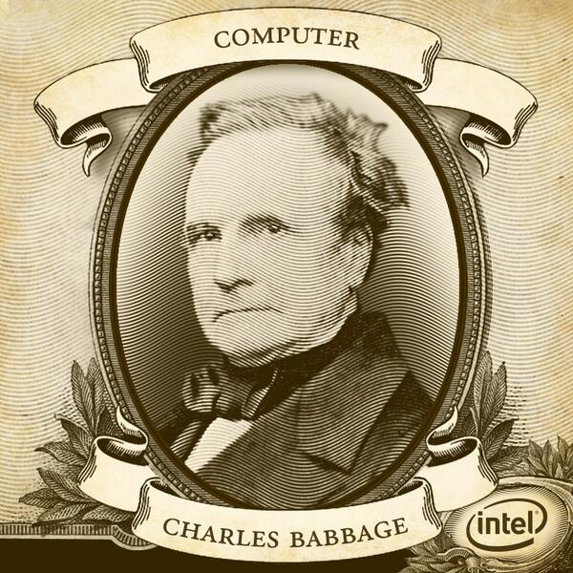
History of Computers
Many people argue that Alan Turing or Konrad Zuse were the fathers of modern computers but it was in fact the eccentric mathematician named Charles Babbage who conceived the first programmable computer as early as the 1830s, a hundred years before Turing’s “Turing Machine”.
Although Babbage’s “Difference Engine” was never built by the man himself, he passed on the plans and in 1991 the Science Museum in London built it exactly to his plans and it worked.
The Difference Engine was extremely primitive by today’s standards as there was of course no internet, or games or even a monitor. The Difference Engine even still used base 10 and not the common binary system used by all computing d
evices now. It still would have revolutionised the world had Babbage had the money to build it during the 1830s but it is enough that he had the idea that caused people to think a different way and he paved the way for the likes of Turing and Zuse to develop their own versions of a computer.
Notes:
Sources: Time Magazine’s article: Who Really Invented the Computer?
http://techland.time.com/2011/11/10/who-really-invented-the-computer/

Slide 4

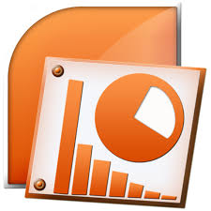



What is a Computer Program?
A computer program is a sequence of instructions for a computer that allows it to carry out its tasks such as word processing, calculations or sending and receiving files.

Slide 5
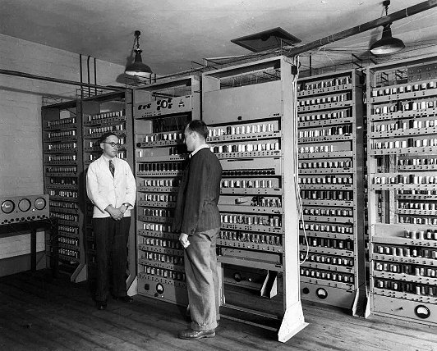
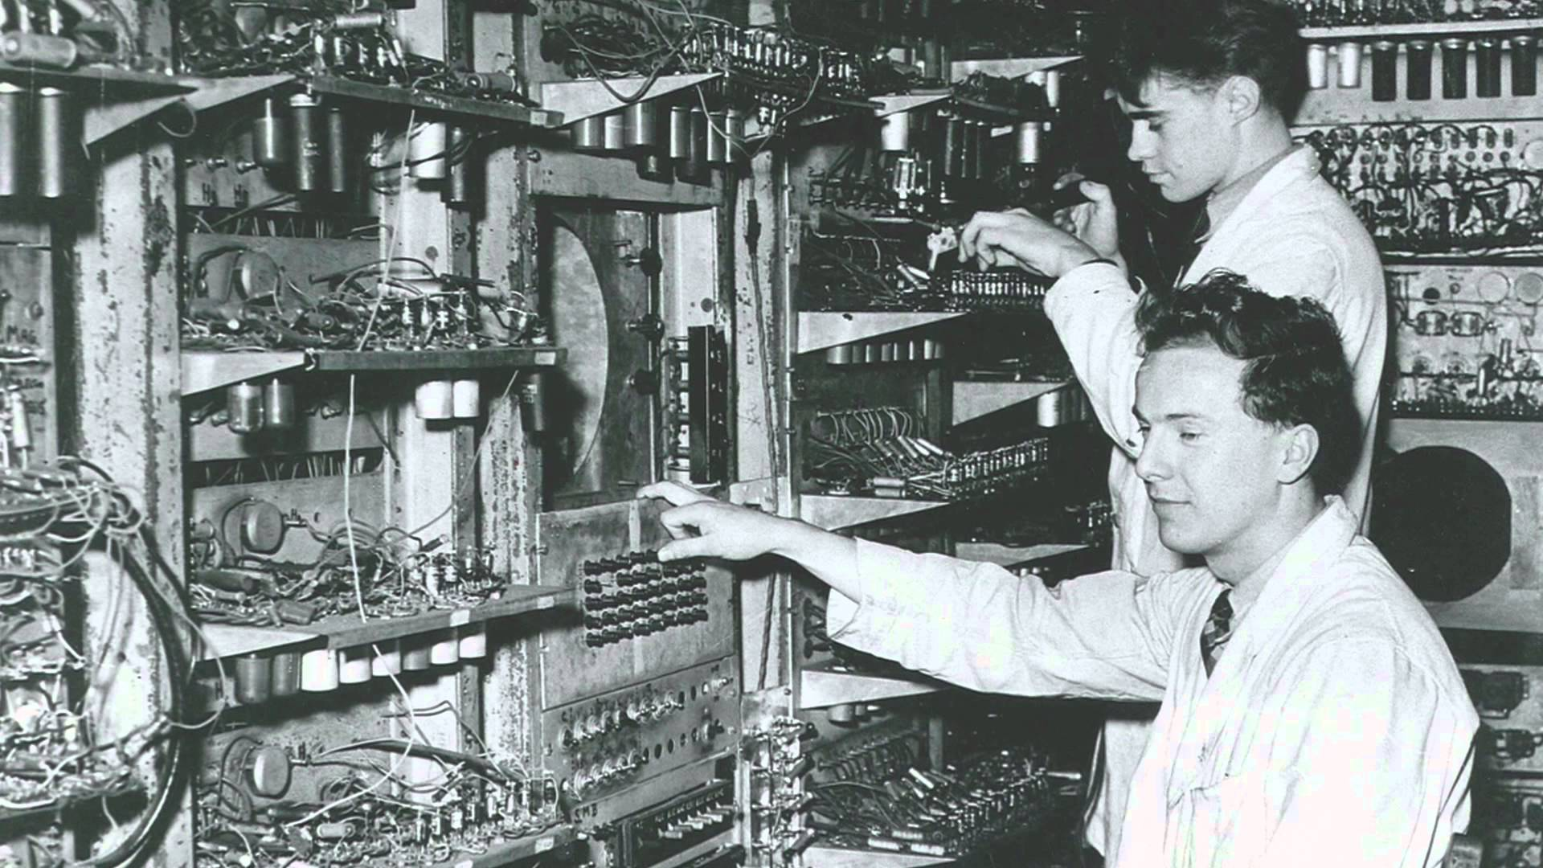
History of Programming
Since the invention of Charles Babbage’s difference engine in 1822, computers have required a means of inputting data and commands. First of all, Computer Languages were composed as a series of steps to wire a particular program. These merged to become a series of steps inputted into a computer which were then executed by the computer. These were the first steps to progress onto the computer programs we have in today’s world.
Some of the 1st programmable computers
Notes:
Source: http://cs.brown.edu/~adf/programming_languages.html

Slide 6
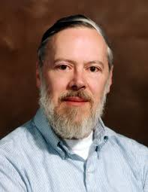
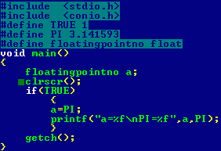
Who Developed C?
C was originally developed by Dennis Ritchie between 1969 and 1973 at AT&T Bell Labs. The origin of C is closely tied to the development of the Unix operating system. It first appeared in Version 2 Unix.

Slide 7
Where is C used?
Pure C is used in very low level operating system coding. It works.

